Slide 1


Slide 2


Slide 3
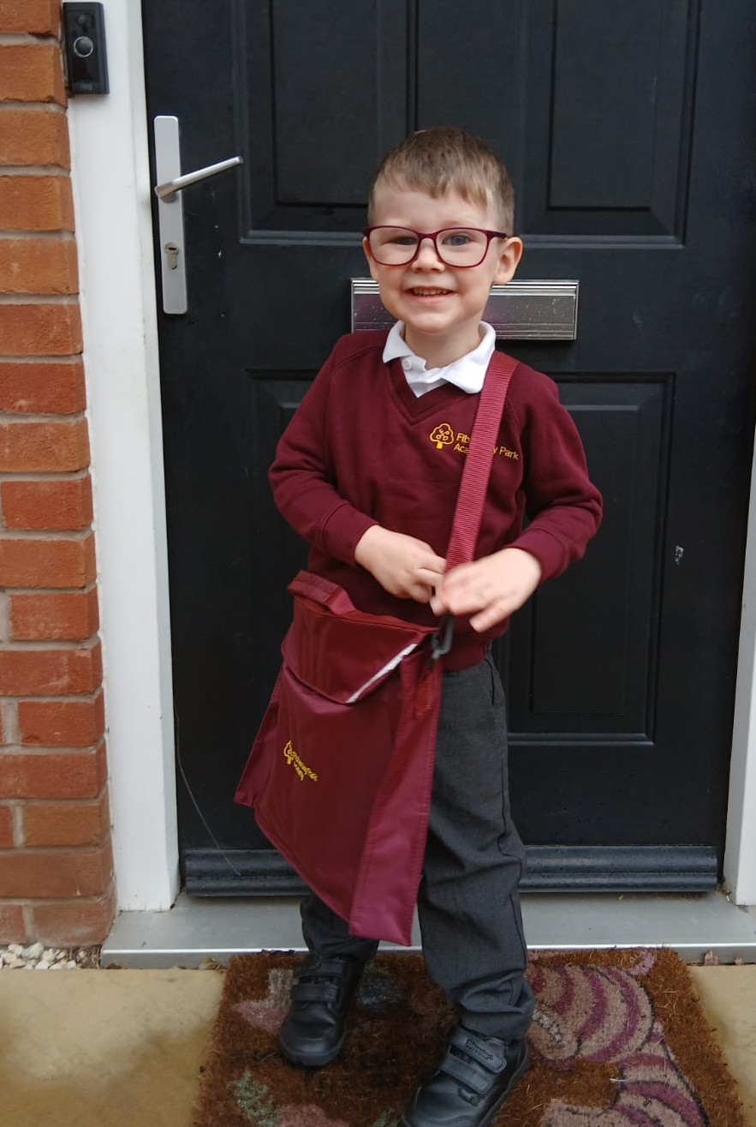

Psalm 16
“Miktam”
  Literary or Musical term
  Golden or Precious
  To cover or whispered in secret
  3 Primary Aspects
  Reliance on God – assurance
  Rejoicing in Relationships – vertical and horizonal
  Thankfulness – now and eternally
The Secret of Contentment

Slide 4
Psalm 16: reliance & assurance
  David in trouble but isn’t complaining
  V.1 – keep me safe; preserve me
  V.8 – I shall not be shaken or moved
  V.10 – You will not abandon me; trusts in resurrection
  David was no stranger to trouble
  Critical wife
  Escape from Saul
  Bathsheba-gate
  Dysfunctional father
  Not in despair or whinging
  Displays a confident trust in God

Slide 5
Psalm 16: who is god?
  1,000+ names and titles for God
  V.1 “Keep me safe, my God”
  V.2 “I say to the LORD”
  V.2 “You are my Lord”
  “Elohim”
  creator, sustainer, all-powerful; Genesis 1 – plural
  “YAHWEH” (YHWH)
  God’s personal name – I AM
  The one Who was, Who is and will be; covenant keeper
  Adonai
  Master; ruler; commander
“I can trust You Elohim to keep me safe because You are my all-powerful creator and sustainer. I commit myself to You YAHWEH because You’ve kept Your promises in the past and will now and forever. You want an intimate relationship with me as Adonai and I submit to Your rule in my life.”

Slide 6
Psalm 16: rejoicing in relationships
  Vertical
  David recognises and honours
  his safe place
  Horizontal
  V.3 I delight in Your holy people
  Do we?
  Who influences us and who do we influence?
  The ungodly run after what’s unsatisfying
  V.1: Elohim is my refuge
  V.2: I have no good thing without You YAHWEH
  V.5: my portion and lot are secure
  V.7: YAHWEH counsels and instructs me at night
  V.8: I’m not shaken when my eyes are on You
“The godly people in the land are my true heroes! I take pleasure in them!” (NLT)

Slide 7
Psalm 16: being thankful
  Present Circumstances
  David acknowledges his benefits
  Future Security: Vs.9-11
  David prophetically foresees resurrection to eternal life
  Body rests secure – now and forever
  Not abandoned to death and decay
  Joy and eternal pleasures
  Messianic prophecy
  Fulfilled by Jesus
  Vs.5&6
  You are my portion and cup
  You make my lot secure
  Pleasant boundaries
  Delightful inheritance
  Give thanks x20 in Psalms
  Peter (Acts 2) & Paul
  (Acts 13)

Slide 8
Psalm 16: TAkeaway
  Secret of Contentment
  Resting in knowing God intimately
  Assured of our security and protection
  Thankfulness in everything
  Confident of an eternal future
“I know what it is to be in need, and I know what it is to have plenty. I have learned the secret of being content in any and every situation, whether well fed or hungry, whether living in plenty or in want. I can do all this through him who gives me strength” Philippians 4:12 (NIVUK)

